Slide 1
Welcome

Slide 2
Why is it important?

Slide 3
Why do we should care?
Performance

Slide 4
Why do we should care?
Performance
Accuracy

Slide 5
Why do we should care?
Performance
Accuracy
Responsiveness

Slide 6
Why should developers care?

Slide 7
Why should developers care?
Faster

Slide 8
Why should developers care?
Faster
Reduce code

Slide 9
Theme
Style
Notes:
Styles and themes on Android allow you to separate the details of your app design from the UI structure and behavior, similar to stylesheets in web design.

Slide 10
Style for a specific view
Notes:
A style is a collection of attributes that specify the appearance for a single View
A style can specify attributes such as font color, font size, background color, and much more.

Slide 11
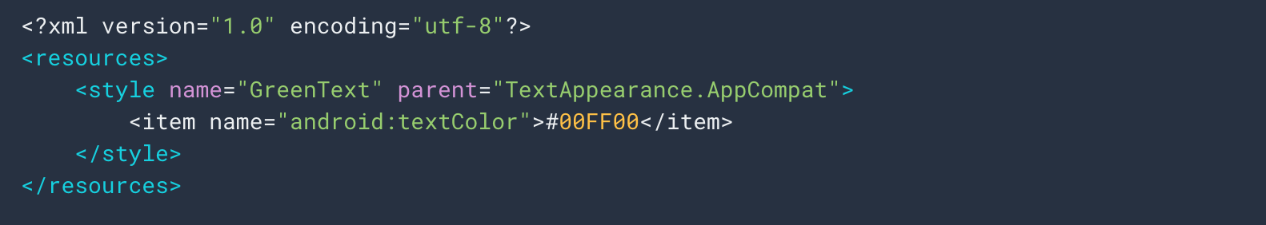
Notes:
A style is a collection of attributes that specify the appearance for a single View
A style can specify attributes such as font color, font size, background color, and much more.

Slide 12
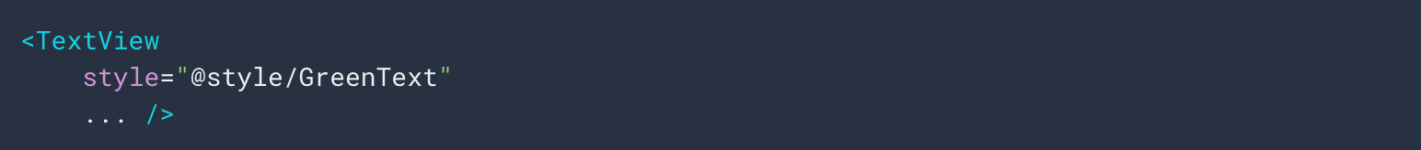

Slide 13
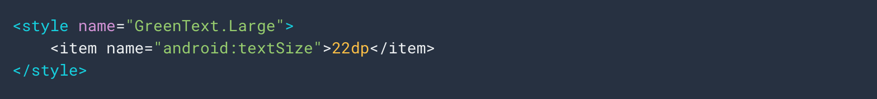

Slide 14
Notes:
Dot system

Slide 15
Theme for an entire application

Slide 16
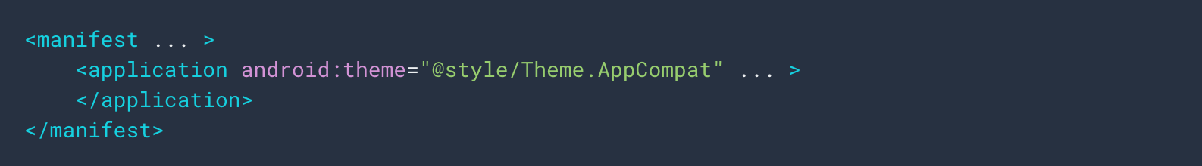

Slide 17
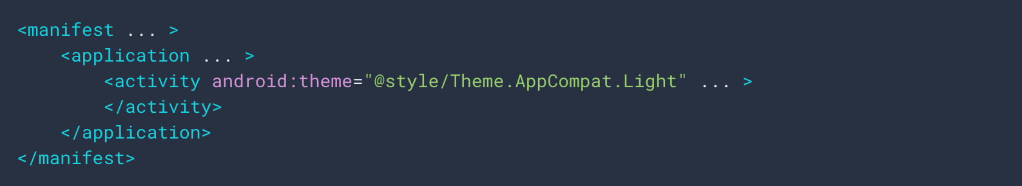

Slide 19
Vector
Bitmap

Slide 22
Bitmap files are a set of pixels in a grid
Vector graphics are describing the objects geometrically.
Notes:
(this means vector can scale with no loss of quality)

Slide 23
9-patch

Slide 24
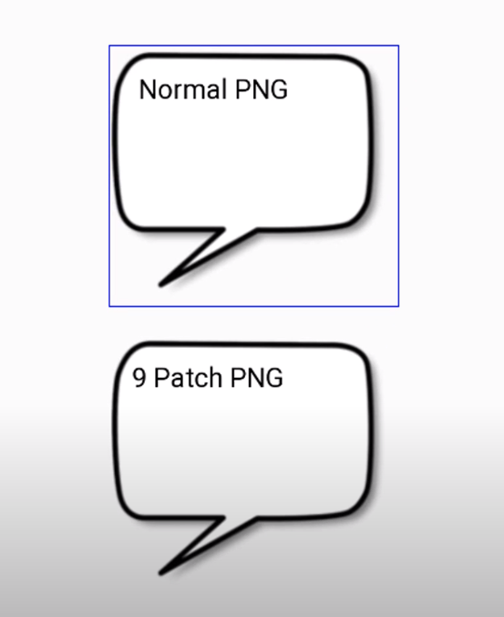

Slide 25
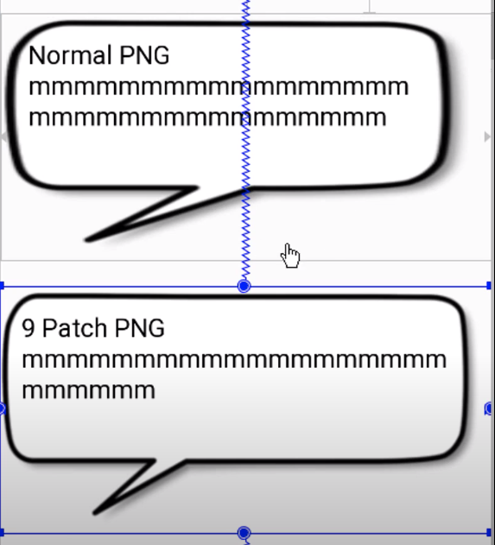

Slide 27
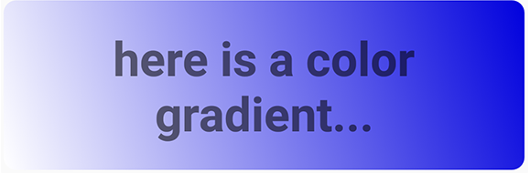
Gradient

Slide 28


Layer-List

Slide 29
Transition

Slide 30
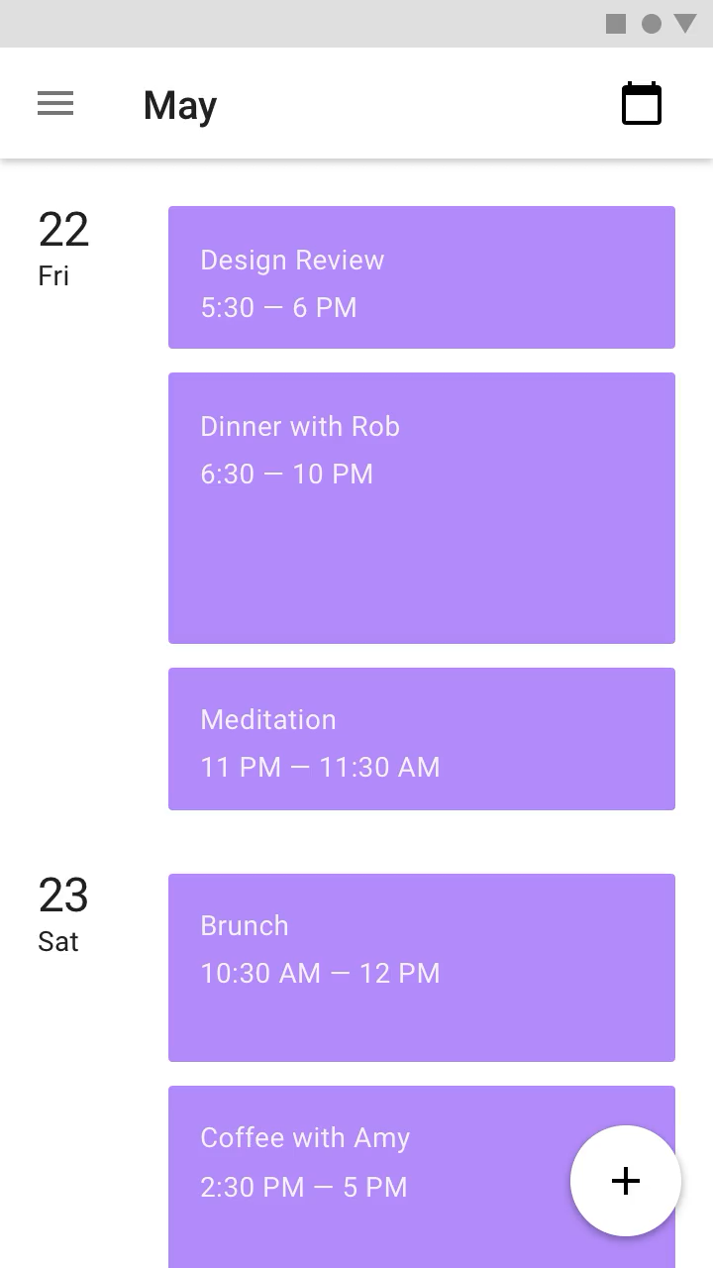
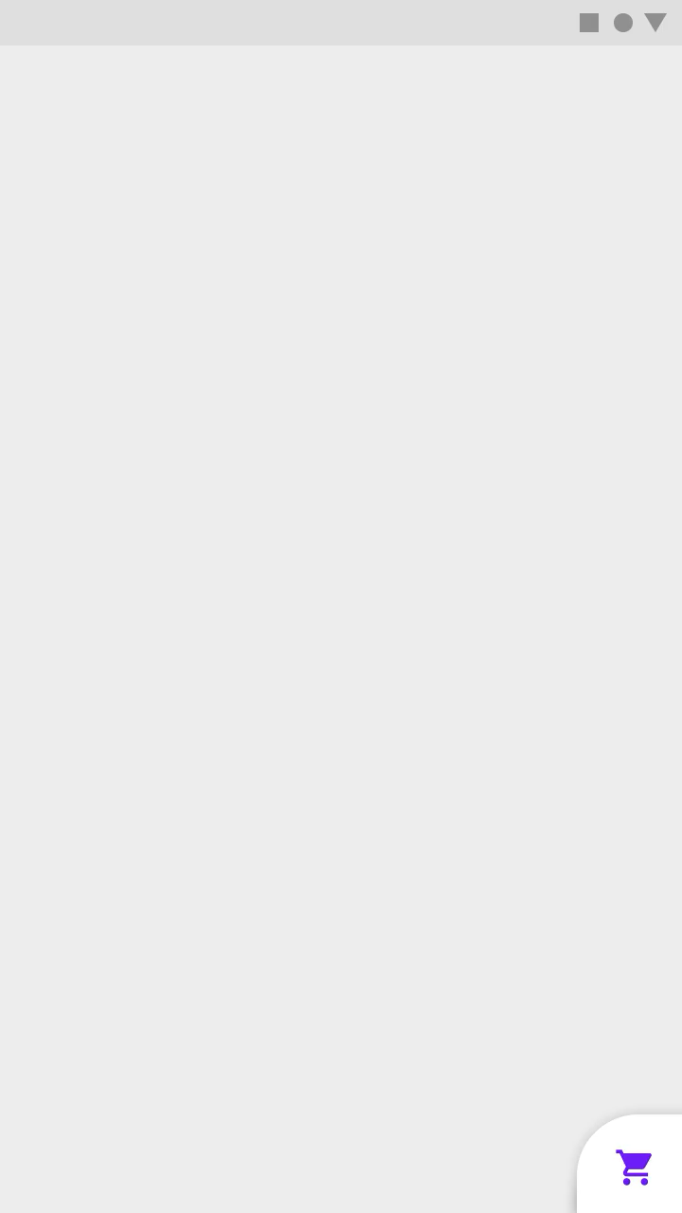

Slide 31
Drawable

Slide 32
Drawable
Generic class used to present any kind of graphic

Slide 33
Image asset Studio
Notes:
Helps you to build multiple versions of each bitmap for different disparate resolutions.
Create your own app icon

Slide 34
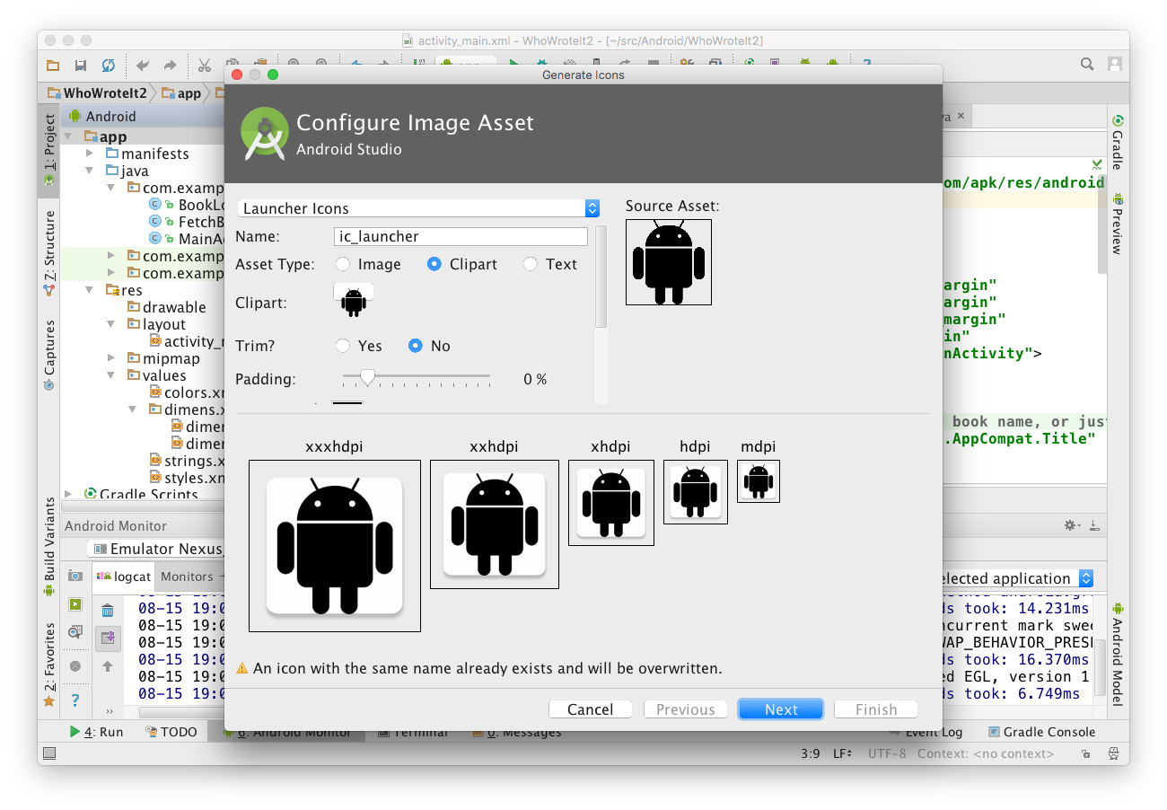
1
2
3
Chose icon typeand change name
Choose Image, Clipart, or Text
Click icon to chose clipart
Inspect assets for multiple screen sizes
4

Slide 35
Vector asset Studio
Notes:
Create one image in xml and it will be able to scale for all different devices.
Create your own app icon

Slide 36
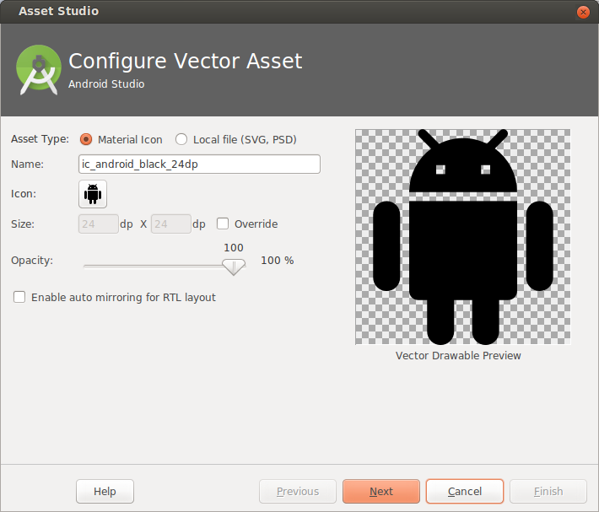
1
2
Choose from Material Icon library, or use your own SVG vector drawing
Opens Material Icon library

Slide 37
Performance tips
Use smallest resolution
Resize, crop, compress
Vector drawings for simple images
Use Lib: Glide or Picasso
Use lossy image formats and adjust quality where possible

Slide 38
Adaptive layout

Slide 39
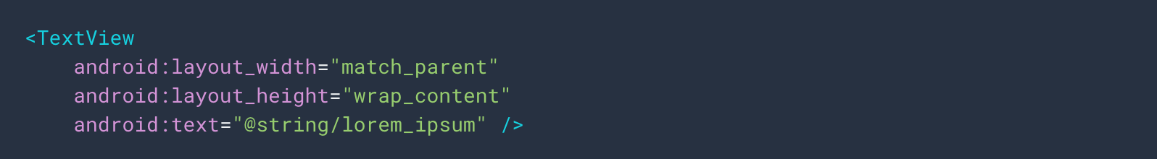

Slide 42
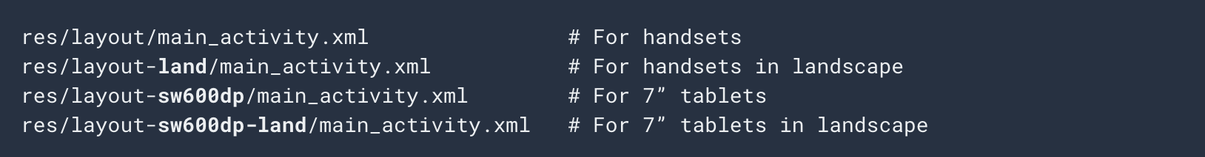

Slide 44
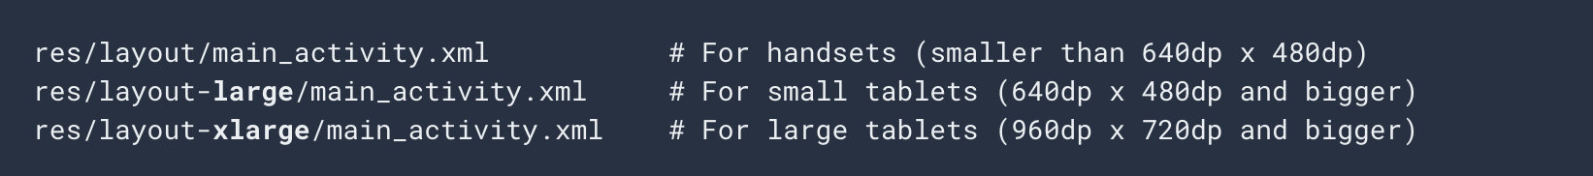

Slide 45
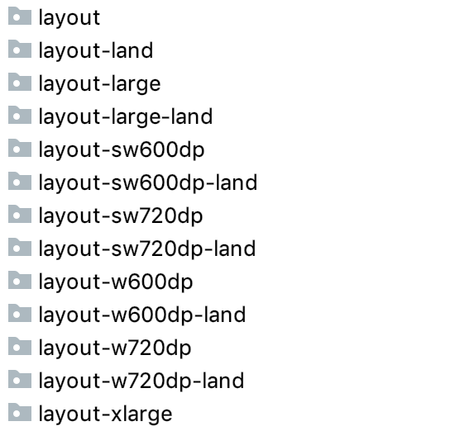

Slide 47
sd = minimum distance between screen edges

Slide 48
d = minimum distance between screen edges

Slide 49
Configuration

Slide 50
getResources().getConfiguration().screenLayout

Slide 51
getResources().getConfiguration().screenLayout
If (getResources().getConfiguration().screenLayout == Configuration.SCREENLAYOUT_SIZE_LARGE) { // doSomething
}

Slide 52
Material.io

Slide 56
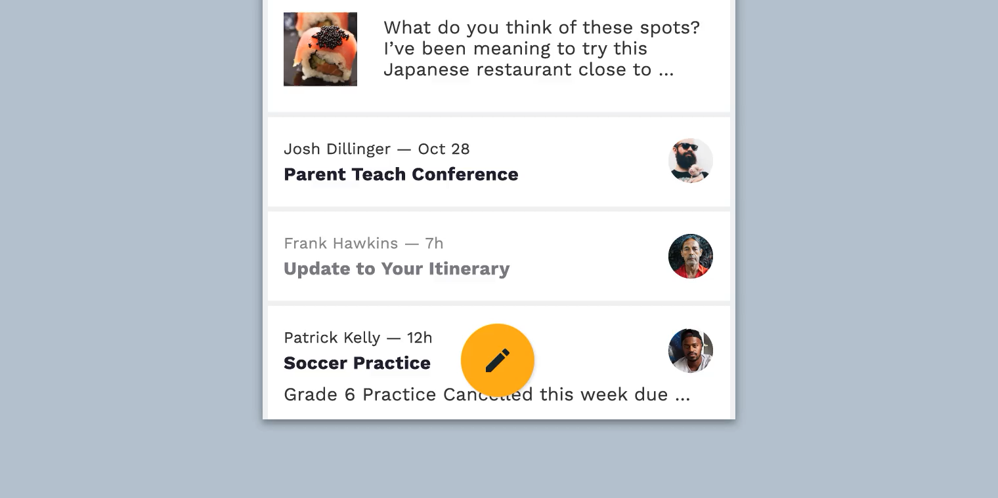

Slide 57
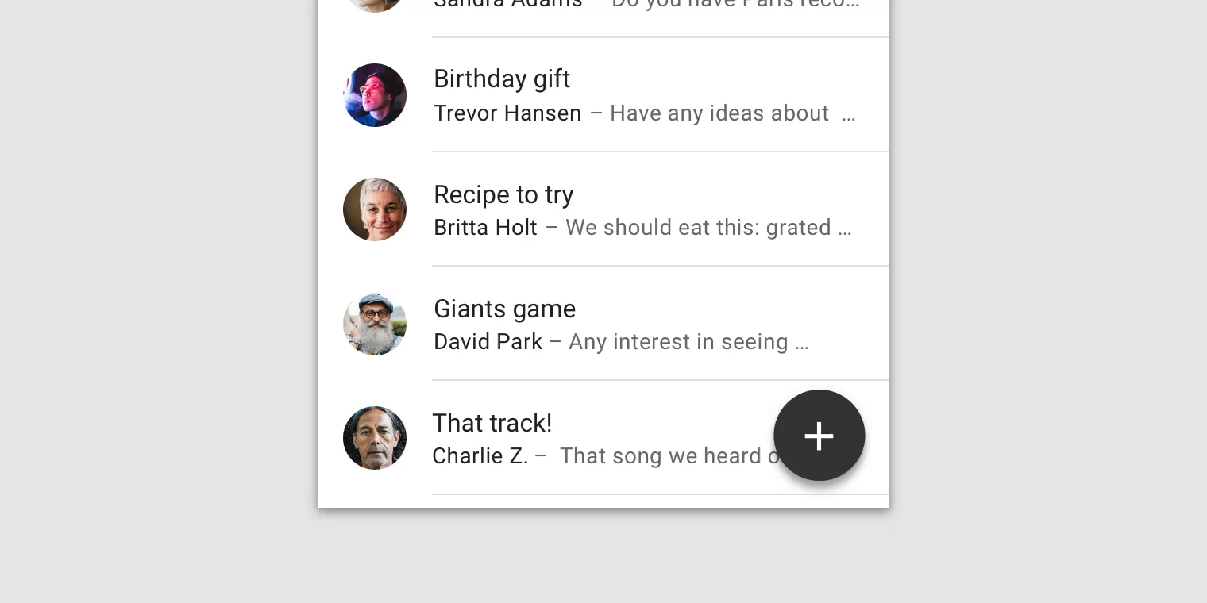


Slide 58
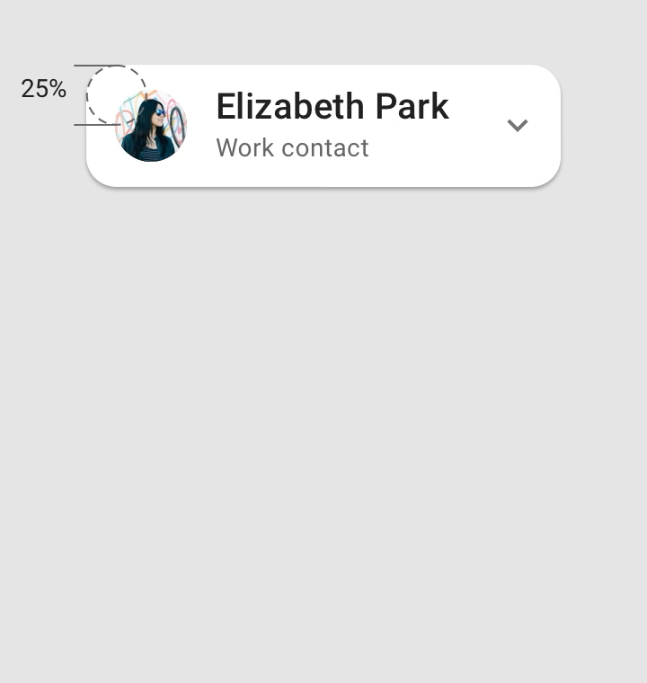
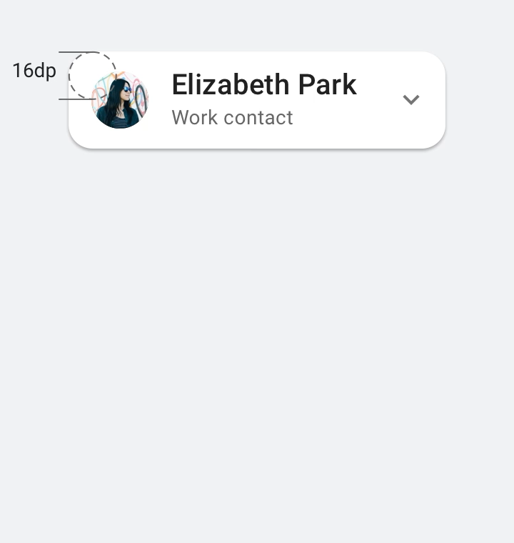

Slide 59
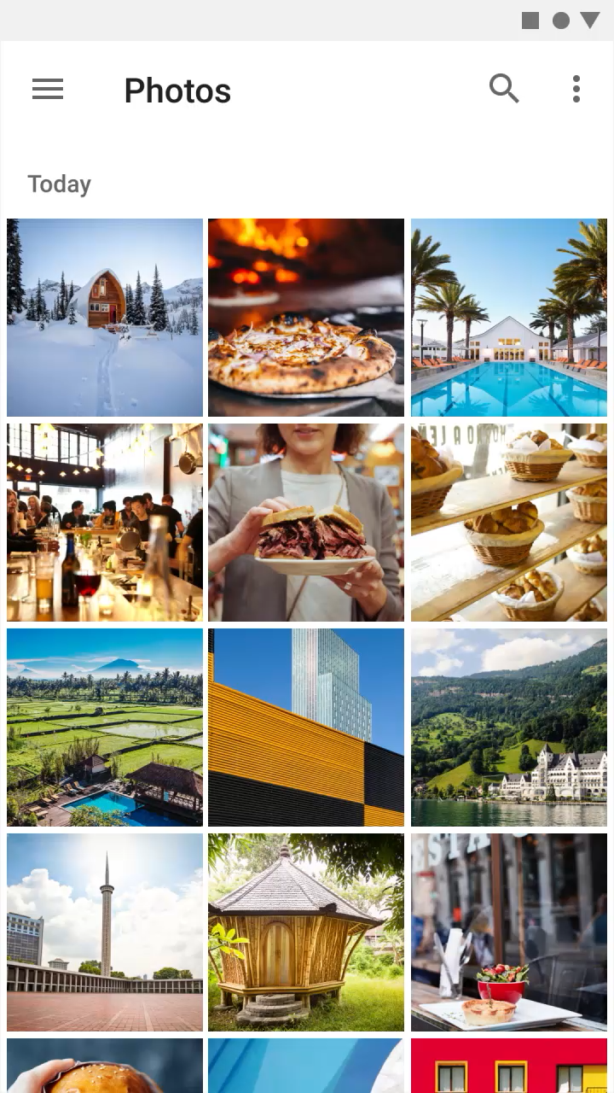
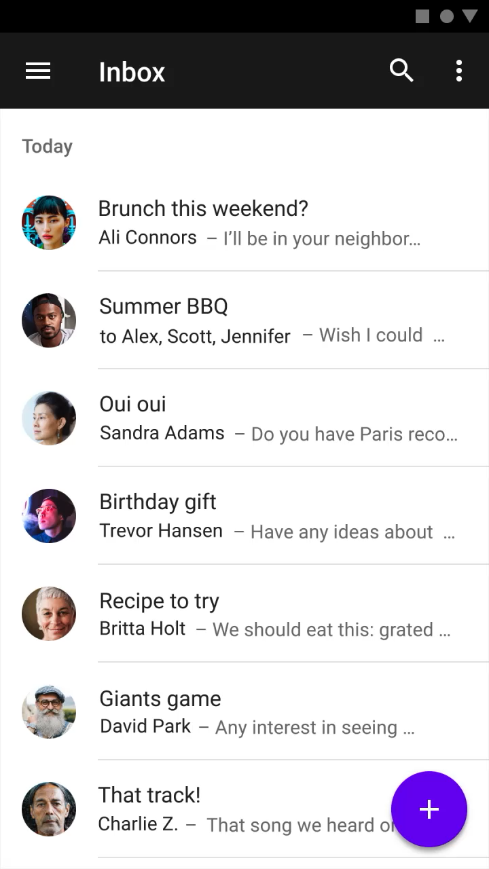

Slide 60
Performance tips

Slide 61
Performance tips
Use smallest resolution

Slide 62
Performance tips
Use smallest resolution
Resize, crop, compress

Slide 63
Performance tips
Use smallest resolution
Resize, crop, compress
Vector drawings for simple images

Slide 64
Performance tips
Use smallest resolution
Resize, crop, compress
Vector drawings for simple images
Use Lib: Glide or Picasso

Slide 65
Performance tips
Use smallest resolution
Resize, crop, compress
Vector drawings for simple images
Use Lib: Glide or Picasso
Use lossy image formats and adjust quality where possible

